Slide 1

BOOK RECOMMENDER PROTOTYPE
FINAL PROJECT
Dàmaris Clariana
Ironhack DAFT May2021

Slide 2
INTRODUCTION
Personal interest
Own data collection
Recommender prototype
SURVEY
Technical features
Characters
Main topics
Descriptions → for text and sentiment analysis

Slide 3
METHOD AND PROCESS

Slide 4
VISUALS

Slide 5

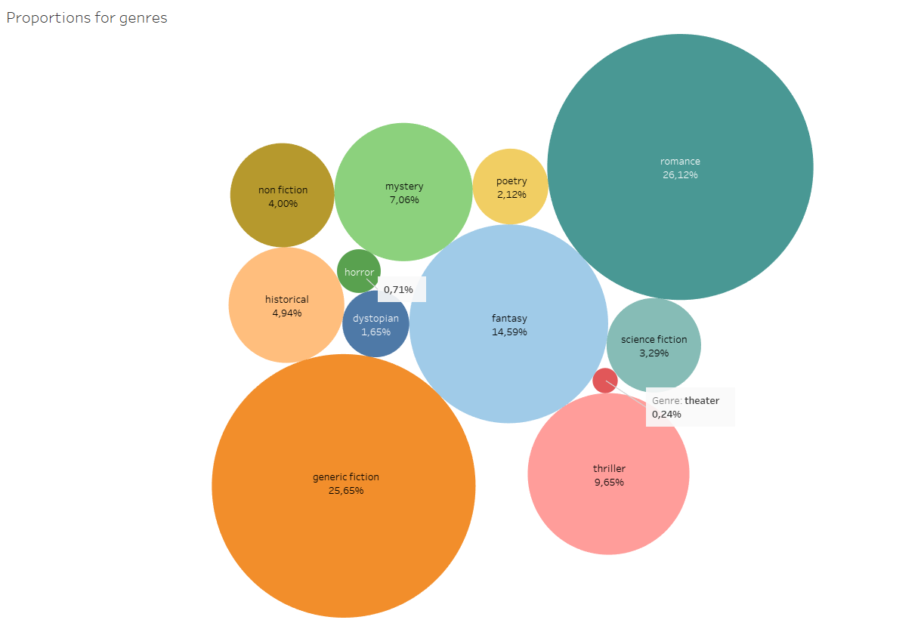
PROPORTIONS BY GENRES

Slide 6
PROPORTIONS BY GENRES

Slide 7
PROPORTIONS BY GENRES

Slide 8
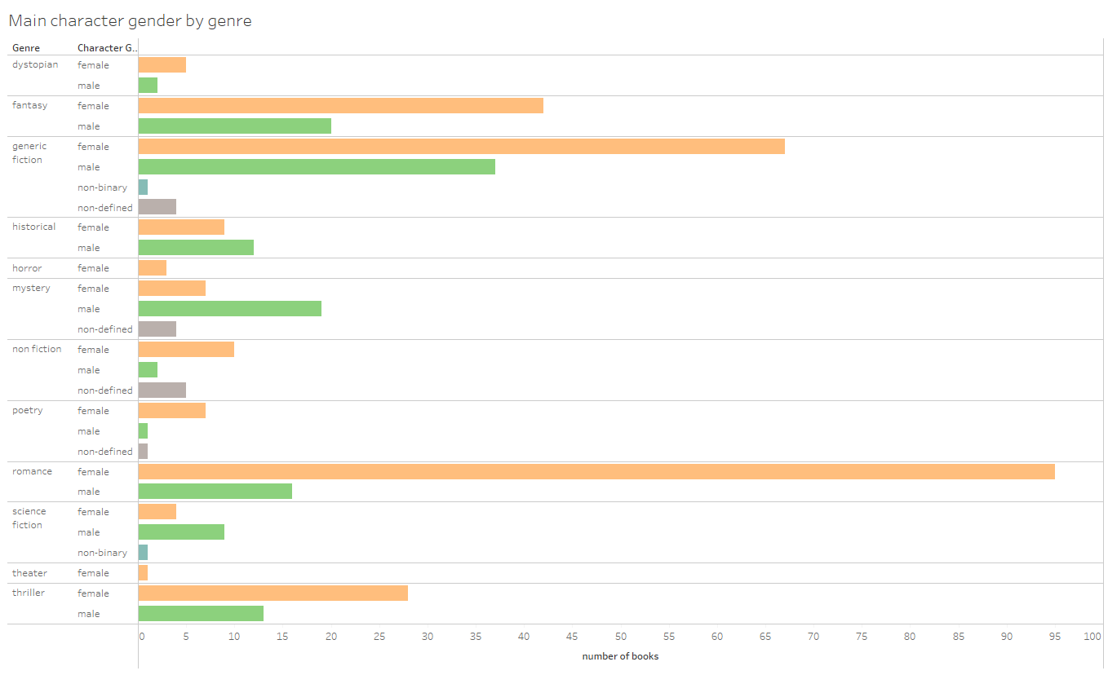
MAIN CHARACTER GENDER BY GENRE

Slide 9
MAIN CHARACTER GENDER BY GENRE

Slide 10
MAIN CHARACTER GENDER BY GENRE

Slide 11
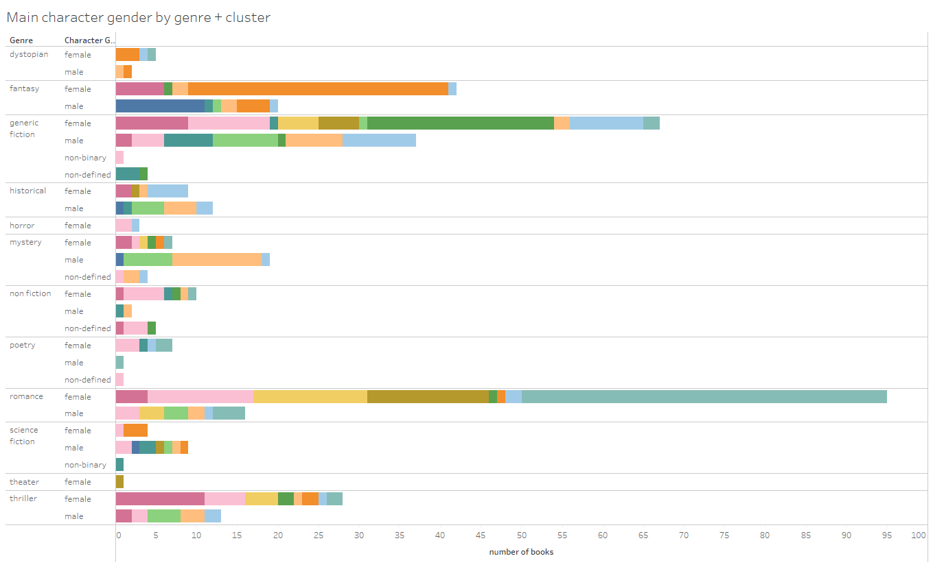
MAIN CHARACTER GENDER BY GENRE + CLUSTER
MAIN CHARACTER GENDER BY GENRE

Slide 12
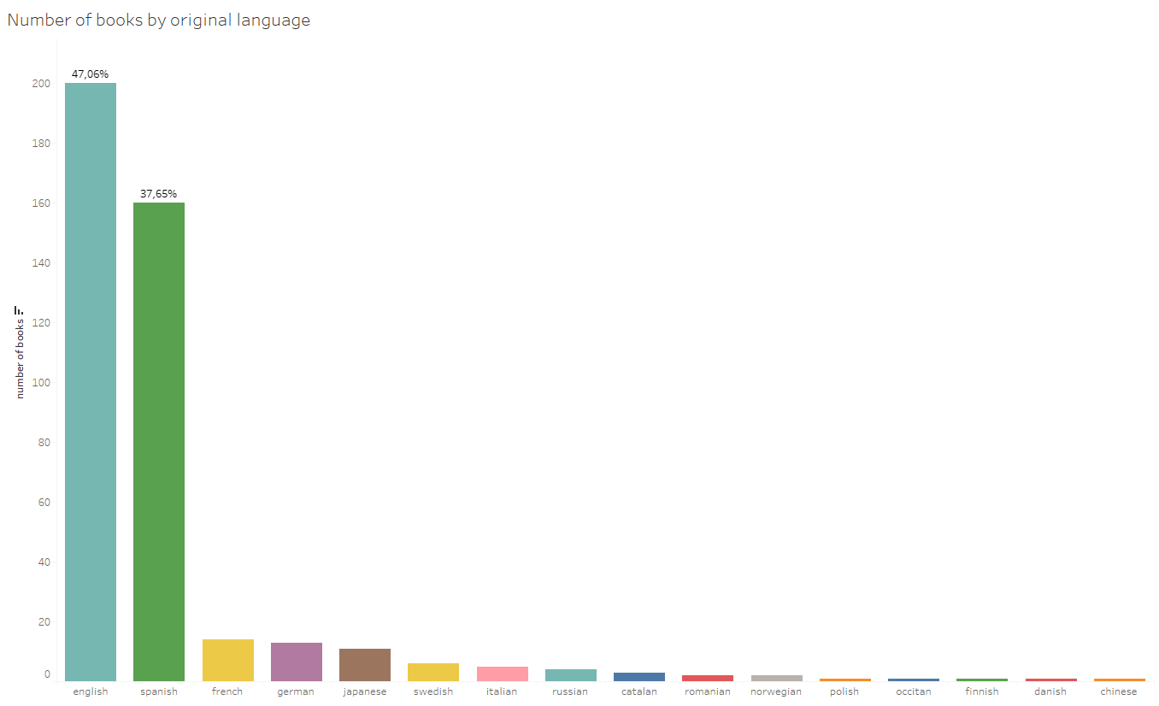
ORIGINAL LANGUAGE

Slide 13
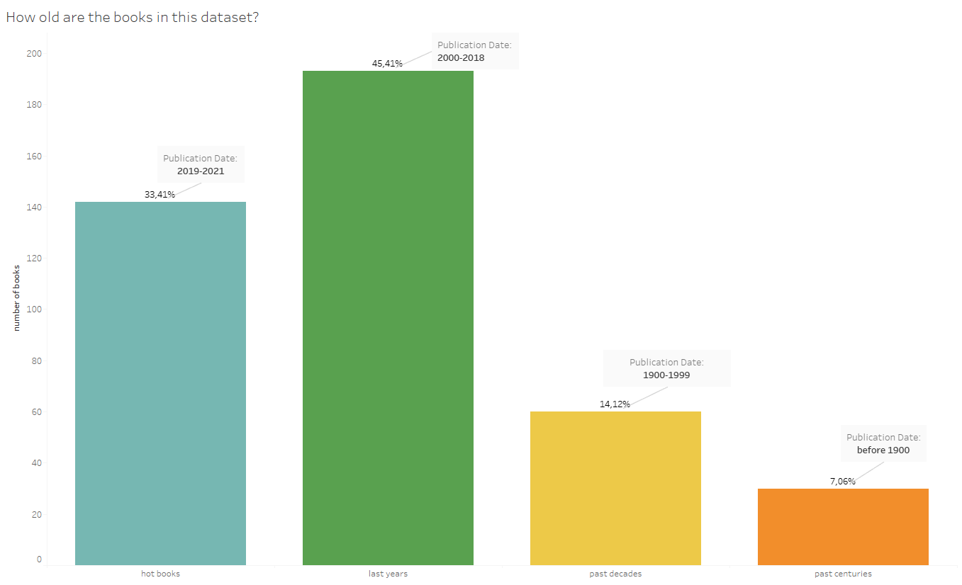
PUBLICATION DATE

Slide 14
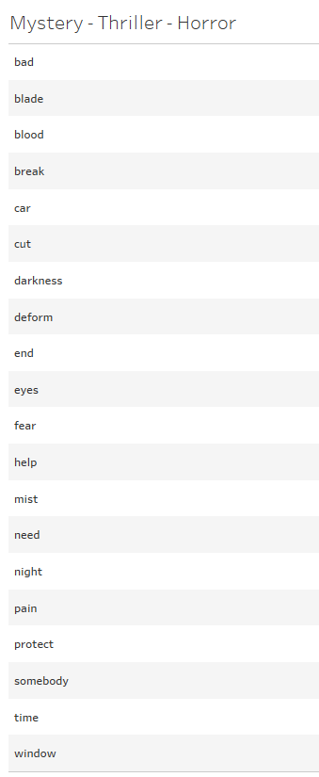
WORD FREQUENCY BY GENRE

Slide 15
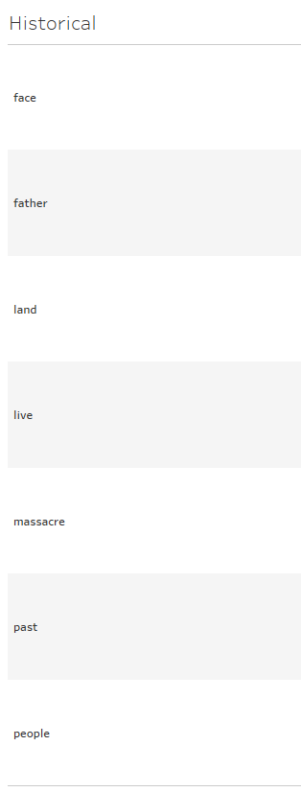
WORD FREQUENCY BY GENRE

Slide 16
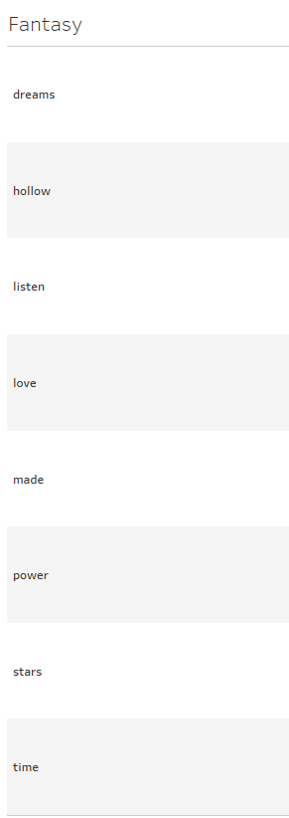
WORD FREQUENCY BY GENRE

Slide 17
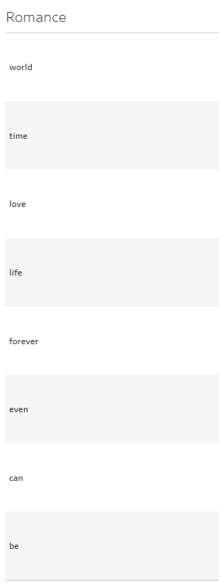
WORD FREQUENCY BY GENRE

Slide 18
RECOMMENDER

Slide 19
LIMITATIONS AND PROJECTION

Slide 20
LIMITATIONS AND PROJECTION
Own data collection
Small dataset
Cleaning data
Time
Improve the project

Slide 21
THANKS!

